Slide 1
Virtual Design Review 2
SD Team 501: NASA Student Launch Competition

Slide 2
Senior Design Team 501
Jedreck Acquissa
Peyton C. Breland
Dylan A. Gardner
Mark A. Ioffredo
Zachary L. Isriel
Role: Recovery & Avionics System Lead
Engineering Interests: Fluid design and food manufacturing
Role: Propulsion System Lead
Engineering Interests: Fluid Design, Flight Vehicle Design and Manufacturing
Role: Airframe Design Lead
Engineering Interests: Fluid Processes, Heat Transfer, and Manufacturing
Role: Payload System Lead
Engineering Interests: Fluid Design and Aerodynamics
Role: Program Director
Engineering Interests: Human spaceflight, spacecraft R&D, commercial launch

Slide 3
VDR1 Summary

Slide 4
Stakeholders and Roles
National Aeronautics and Space Administration
Launch Service Client
Competition Organizer
Shayne McConomy,
Ph.D.
Functional Manager
ME Senior Design Coordinator
Project Sponsor
Chiang Shih,
Ph.D.
Project Advisor
AME Center Director
AIAA Student Org. Advisor
William Oates,
Ph.D.
Project Investor
ME Department Chair

Slide 5
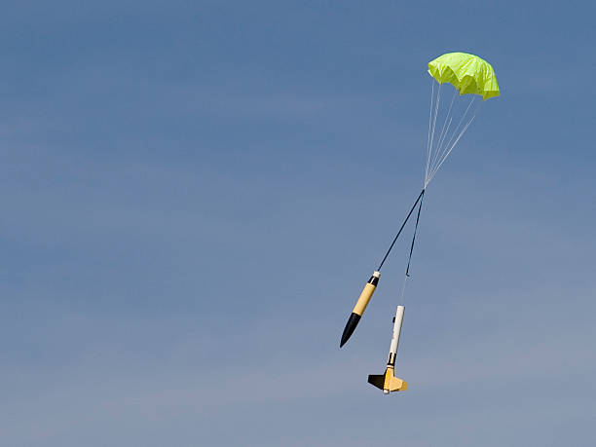
Project Objective
Fly a high-power solid rocket to an altitude between 4,000 and 6,000 feet that will deploy a scientific information gathering payload, after the flight vehicle is safely recovered.

Slide 6
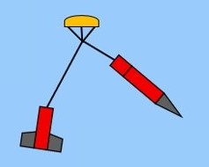
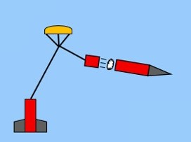
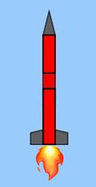
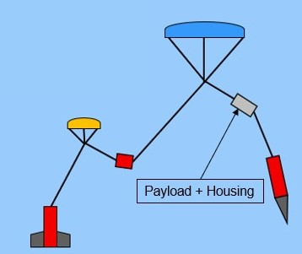
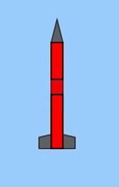
Flight Profile Overview
Apogee ~4600 ft
Separation 1
Drogue Deploy
High-velocity
descent phase
Ascent Phase
~550 ft
Separation 2
Main & payload deploy
Low-velocity
descent phase
Vehicle on Launch Rail
6

Slide 7
Project Scope – Key Goals
Successful and accurate flight test
From apogee to touchdown in under 85 seconds
Reach within 100 ft of the proposed apogee
Payload is to complete a series of tasks with a scientific purpose
Maintain a mid-flight stability margin between 3 and 4 calibers
Be awarded for at least one of the competition categories

Slide 8
Customer Needs
The flight vehicle can place top 3 in one or two of the award categories
The design will feature robust parts and modular features for replaceability
The payload can be a rover or other device, but not a UAS (unmanned aerial system)
The rocket is powered by one solid propellant motor system with impulse under 5,120 Newton-seconds.

Slide 9
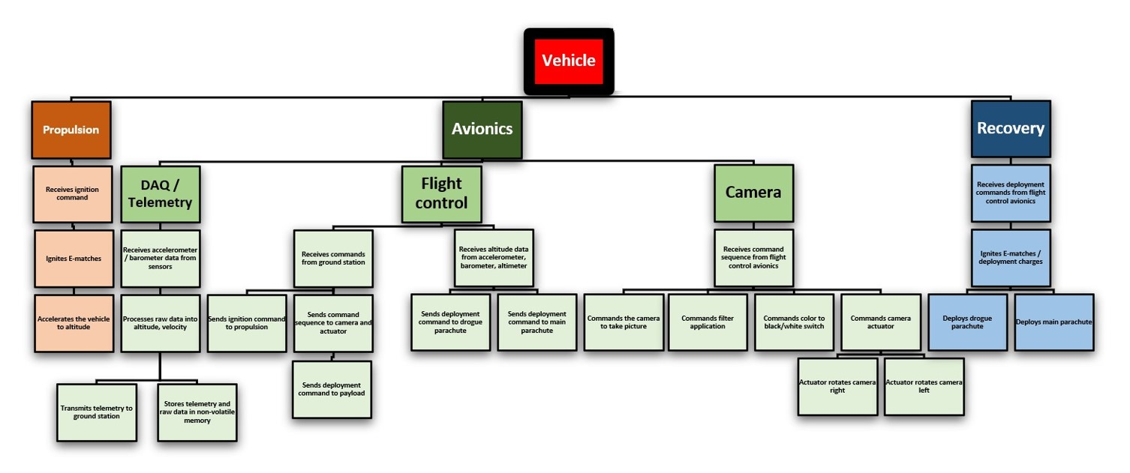
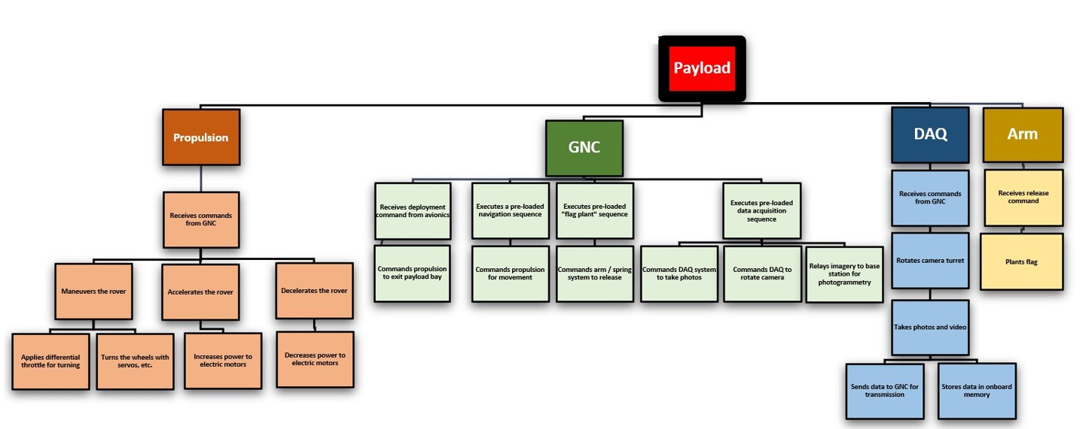
Functional Decomposition
Zenith I
Vehicle
Propulsion
Avionics
Recovery
Payload
Propulsion
GNC
DAQ
Receives ignition command
Accelerates the vehicle to altitude
Ignites E-matches
DAQ / Telemetry
Flight control
Receives accelerometer / barometer data from sensors
Transmits telemetry to ground station
Stores telemetry and raw data in non-volatile memory
Receives commands from ground station
Sends ignition command to propulsion
Receives altitude data from accelerometer, barometer, altimeter
Sends deployment command to drogue parachute
Sends deployment command to main parachute
Sends deployment command to payload
Receives deployment commands from flight control avionics
Ignites E-matches / deployment charges
Deploys drogue parachute
Deploys main parachute
Processes raw data into altitude, velocity
Accelerates the rover
Decelerates the rover
Maneuvers the rover
Increases power to electric motors
Decreases power to electric motors
Applies differential throttle for turning
Turns the wheels with servos, etc.
Executes a pre-loaded navigation sequence
Camera
Receives command sequence from flight control avionics
Sends command sequence to camera and actuator
Commands the camera to take picture
Commands filter application
Commands color to black/white switch
Commands camera actuator
Actuator rotates camera right
Actuator rotates camera left
Commands propulsion for movement
Executes pre-loaded "flag plant" sequence
Commands arm / spring system to release
Executes pre-loaded data acquisition sequence
Commands DAQ system to take photos
Commands DAQ to rotate camera
Receives commands from GNC
Relays imagery to base station for photogrammetry
Takes photos and video
Rotates camera turret
Stores data in onboard memory
Sends data to GNC for transmission
Receives deployment command from avionics
Commands propulsion to exit payload bay
Receives commands from GNC
Arm
Receives release command
Plants flag

Slide 10
Targets and Metrics

Slide 11
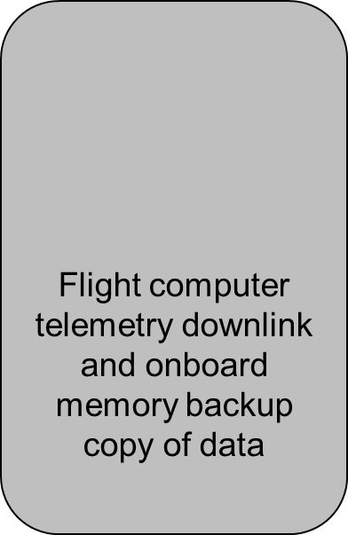
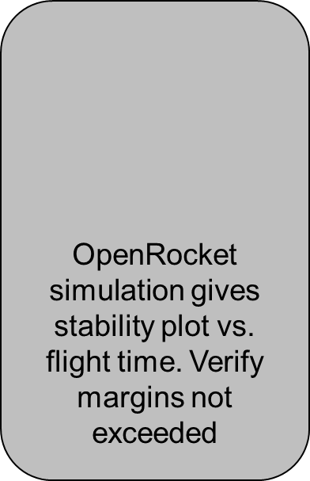
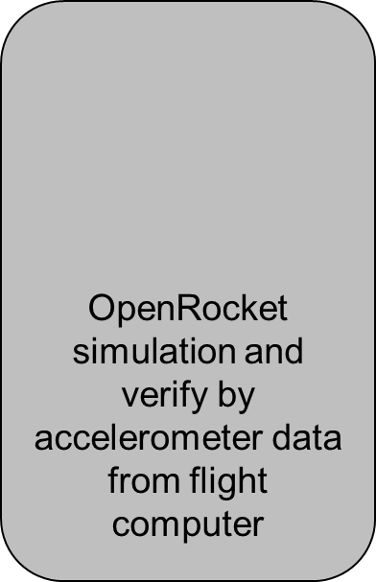
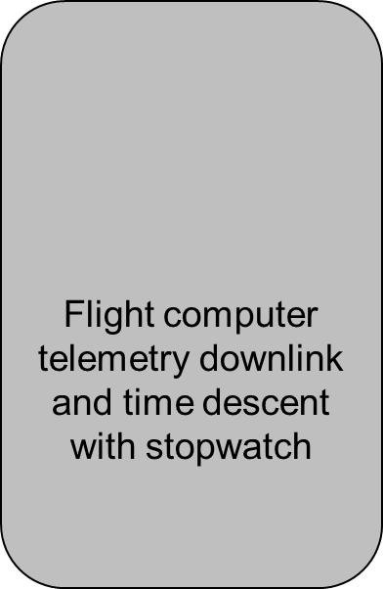
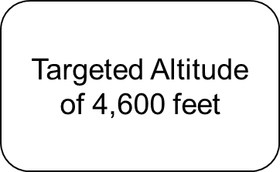
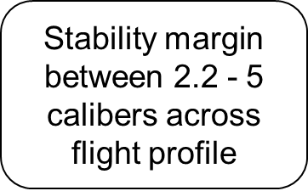
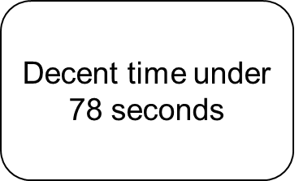
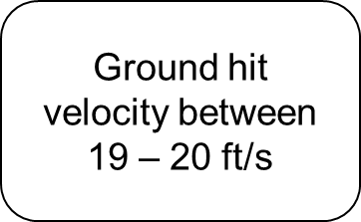
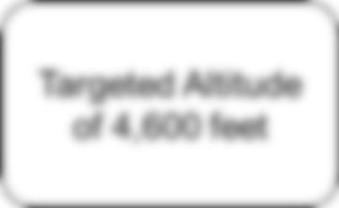
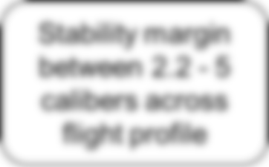
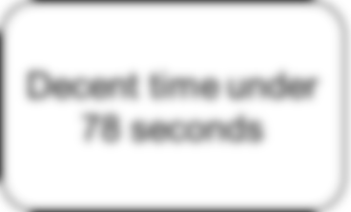
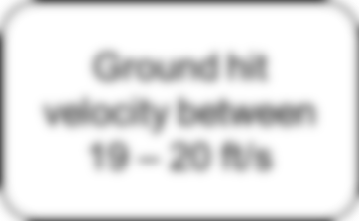

Slide 12
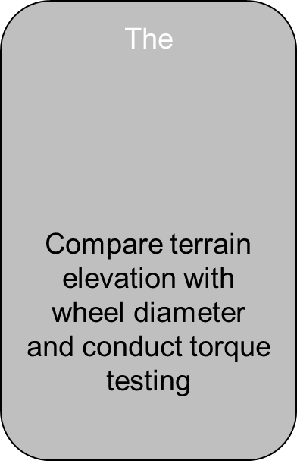
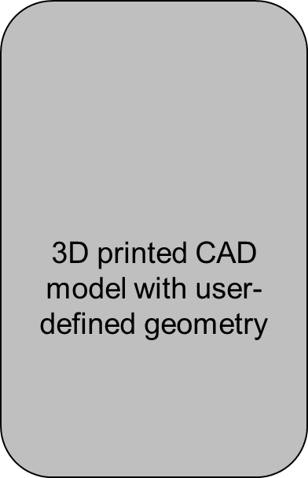
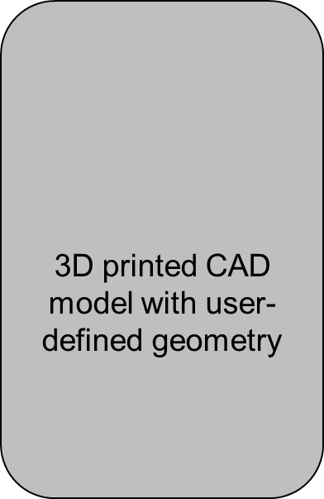
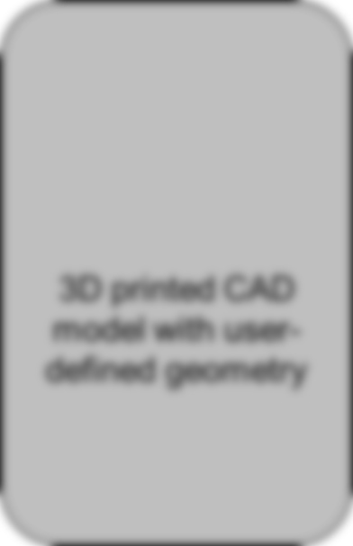
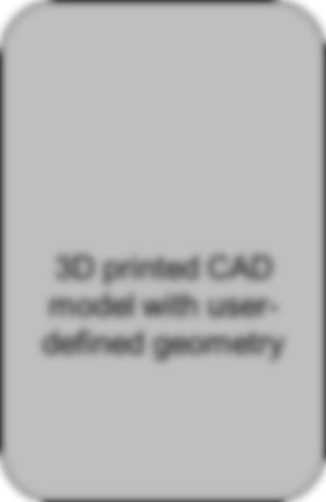
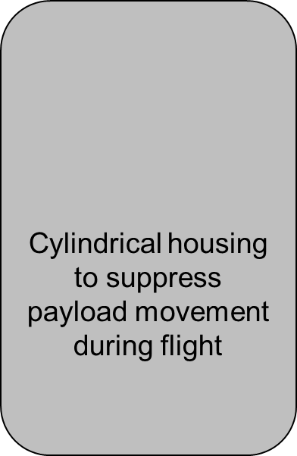
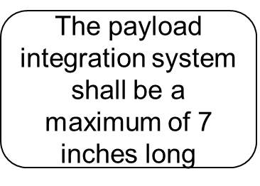
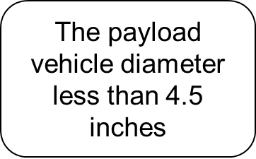
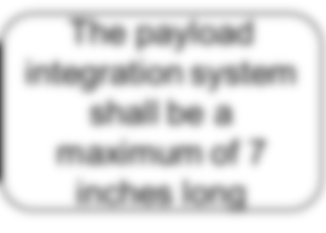
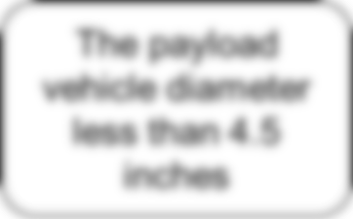
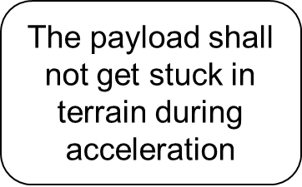
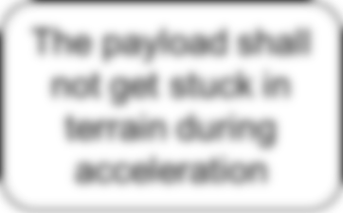
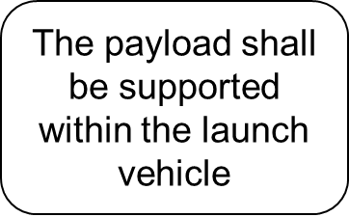
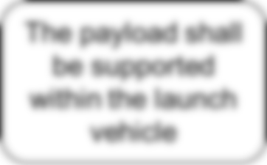

Slide 13
Concept Generation

Slide 14
High Fidelity Concepts - Launch Vehicle
1
Solid motor, dual deployment, drogue + main chute, CO2 ejection system, 3-D printed fins (clipped delta geometry), removable fins, LD-Haack series 3-D printed nose
2
Solid motor, dual deployment, drogue + main chute, CO2 ejection system, fixed trapezoidal plywood fins, ogive 3-D printed nose
3
Solid motor, dual deployment, streamer + main chute, black powder ejection system, fixed 3-D printed fins (delta geometry), LV-Haack series 3-D printed nose

Slide 15
Medium Fidelity Concepts - Launch Vehicle
4
Solid motor, dual deployment, drogue + main chute, CO2 ejection system, fixed plywood delta fins, LV-Haack series 3-D printed nose
5
Solid motor, dual deployment, drogue + main chute, black powder ejection system, fixed 3-D printed fins (clipped delta geometry) ogive 3-D printed nose
6
Solid motor, dual deployment, streamer + main chute, CO2 ejection system, 3-D printed fins (clipped delta geometry), removable fins, conical commercial bought nose
7
Solid motor, dual deployment, streamer + main chute, black powder ejection system, plywood trapezoidal fins, removable fins, elliptical commercial bought nose
8
Solid motor, dual deployment, streamer + main chute, CO2 ejection system, plywood fixed delta fins, LV Haack 3-d print nose

Slide 16
High Fidelity Concepts - Payload
1
Independent motor drive, spiked 2-wheel, Arduino Mega controlled, Terrain Image Processing, and a tether
2
Single motor drive, spiked 2-wheel, Raspberry Pi controlled, Sow crops
3
Dual motor drive, tank treads, Arduino mega controlled, soil collection

Slide 17
Medium Fidelity Concepts - Payload
4
Single Motor, tank tread, Raspberry Pi and Soil Sample Collection
5
Independent motor drive, 4-wheel, Arduino Mega and flag plant
6
Independent motor drive, Spiked 2-Wheel, Arduino Mega, Sow Crops, and a tether
7
Single Motor, Spiked 2-Wheel, Arduino Mega, Terrain Image Processing
8
Independent motor drive, Spiked 2-Wheel, Raspberry Pi, flag plant, and sled for stability

Slide 18
Concept Selection: Launch Vehicle

Slide 19
Launch Vehicle Pairwise Comparison
Customer Needs |  | 1 | 2 | 3 | 4 | 5 | 6 | 7 | 8 | Total
1 | Reusable vehicle | - | 0 | 0 | 0 | 0 | 0 | 0 | 0 | 0
2 | Stability across flight profile | 1 | - | 1 | 1 | 1 | 1 | 1 | 1 | 7
3 | Controlled descent | 1 | 0 | - | 1 | 0 | 1 | 1 | 1 | 5
4 | Successful recovery | 1 | 0 | 0 | - | 0 | 1 | 1 | 0 | 3
5 | Body sections sucessfully separate | 1 | 0 | 1 | 1 | - | 1 | 1 | 1 | 6
6 | Acceptable TWR | 1 | 0 | 0 | 0 | 0 | - | 1 | 0 | 2
7 | Minimal drift on descent | 1 | 0 | 0 | 0 | 0 | 0 | - | 0 | 1
8 | Achieves target altitude | 1 | 0 | 0 | 1 | 0 | 1 | 1 | - | 4
Total |  | 7 | 0 | 2 | 4 | 1 | 5 | 6 | 3 | n-1 = 7
Importance Weight Factors
7 | Stable across flight profile
6 | Body sections sucessfully separate
5 | Controlled descent
4 | Achieves target altitude
3 | Successful landing
2 | Acceptable TWR
1 | Minimal drift on descent
0 | Reusable vehicle
To HOQ

Slide 20
Launch Vehicle HOQ
 |  | Engineering Characteristics
Improvement Direction |  | ↓ | ↑ | ↓ | ↑ | ↑ | ↓ | ↑ | ↓ | ↓ | ↑ | ↓ | ↑ | ↓ | ↓ | ↓ | ↓ | ↑ | ↓
Units |  | in | in | lb | s | in | lb | ft/s | ft/s^2 | ft/s | ft | ft | ft/s | ft-lb | s | // | rad/s | lb | deg F
Customer Requirements | Importance Weight Factor | Cg Location from base | Cp Location from base | Thrust | Burn time | Body Length | Mass | Velocity off Rod | Acceleration | Max Velocity | Apogee | Lateral Drift | Descent Rate | Impact Energy | Descent Time | Drag Coef. | Spin Rate | Ejection Force | Ejection Gas Temp
Stability across flight profile | 7 | 9 | 9 |  | 3 | 3 | 3 |  | 1 | 3 |  |  |  |  |  |  | 3
Body sections sucessfully separate | 6 |  |  |  |  |  |  |  | 3 | 3 |  |  |  |  |  |  |  | 9
Controlled descent | 5 |  |  |  |  |  |  |  |  |  |  |  | 9 |  | 3
Achieves target altitude | 4 |  |  | 9 |  |  | 9 | 1 |  |  | 9 |  |  |  |  | 9 |  |  | 9
Successful recovery | 3 |  |  |  |  |  |  |  | 1 |  | 3 | 3 | 9 | 9 | 3 |  |  | 9
Acceptable TWR | 2 |  |  | 9 |  |  | 9
Minimal drift on descent | 1 |  |  |  |  | 9 |  |  |  |  |  | 9 |  |  |  | 3 | 1
Reusable vehicle | 0 |  |  |  |  |  |  |  | 3 |  |  |  |  | 9 |  |  |  |  | 9
Raw Score | 683 | 63 | 63 | 54 | 21 | 21 | 75 | 4 | 28 | 39 | 45 | 9 | 72 | 27 | 24 | 36 | 21 | 81 | 36
Relative Weight % |  | 9.2 | 9.2 | 7.9 | 3.1 | 3.1 | 11.0 | 0.6 | 4.1 | 5.7 | 6.6 | 1.3 | 10.5 | 4.0 | 3.5 | 5.3 | 3.1 | 11.9 | 5.3
Rank Order |  | 4 | 4 | 5 | 12 | 12 | 2 | 14 | 9 | 7 | 6 | 13 | 3 | 10 | 11 | 8 | 12 | 1 | 8
Engineering Characteristic Rank Order
1 | Ejection Force
2 | Mass
3 | Descent Rate
4 | Cp Location from base
4 | Cg Location from base
5 | Thrust
6 | Apogee
7 | Max Velocity
8 | Ejection Gas Temp.
8 | Drag Coef.
9 | Acceleration
10 | Impact Energy
11 | Descent Time
12 | Burn time
12 | Body Length
12 | Spin Rate
13 | Lateral Drift
14 | Velocity off Rod
To Selection

Slide 21
Launch Vehicle Selection Criteria
Engineering Characteristic Rank Order
1
Ejection Force
2
Mass
3
Descent Rate
4
Cp Location from base
4
Cg Location from base
5
Selection Criteria
Thrust
6
Low Mass
Apogee
7
Mild Descent Rate
To Pugh Chart
Customer Needs?
Max Velocity
Stability
8
Low Ejection Gas Temp.
Ejection Gas Temp.
8
Drag Coefficient
Reusability
Modularity
Drag Coef.
9
Low Impact Energy
Acceleration
10
Stability
Impact Energy
11
Modularity
Descent Time
12
Burn time
12
Body Length
12
Spin Rate
13
Lateral Drift
14
Velocity off Rod

Slide 22
Launch Vehicle Selection – Round 1
Selection Criteria
Concepts
8
1
2
3
4
5
6
7
Low Mass
+
s
+
s
+
+
s
Mild Descent Rate
+
+
s
+
+
s
s
Low Ejection Gas Temp.
s
s
-
s
-
s
-
Drag Coefficient
Datum
+
+
s
+
+
+
-
Low Impact Energy
+
s
s
s
+
s
-
Stability
+
+
s
s
+
+
-
Modularity
+
s
s
+
-
+
s
# of Plus(+)
6
4
1
3
5
4
0
# of Minus(
-
)
0
0
1
0
1
0
4

Slide 23
Launch Vehicle Selection – Round 2
Selection Criteria
Concepts
1
2
5
6
Low Mass
-
s
s
Mild Descent Rate
-
s
-
Low Ejection Gas Temp.
s
-
s
Drag Coefficient
Datum
+
+
+
Low Impact Energy
-
s
-
Stability
-
-
s
Modularity
-
-
s
# of Plus(+)
1
1
2
# of Minus(
-
)
5
2
3
1
Solid motor, dual deployment, drogue + main chute, CO2 ejection system, 3-D printed fins (clipped delta geometry), removable fins, LD-Haack series 3-D printed nose

Slide 24
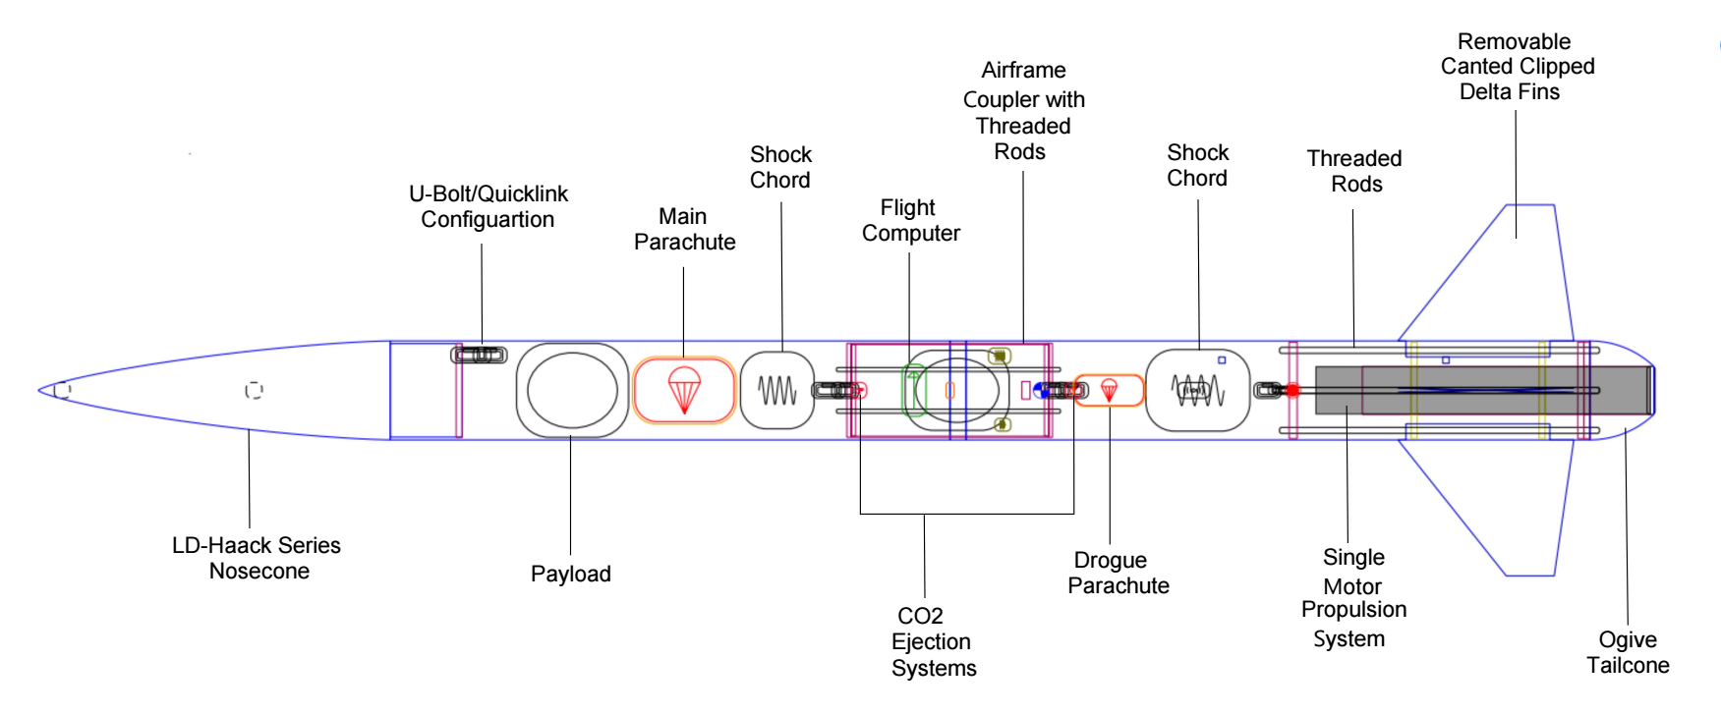
Launch Vehicle Selected Design

Slide 25
Launch Vehicle Selected Design

Slide 26
Concept Selection: Payload

Slide 27
Payload Pairwise Comparison
Customer Needs |  | 1 | 2 | 3 | 4 | 5 | Total
1 | Payload remains immobile in during flight | - | 0 | 0 | 1 | 1 | 2
2 | Payload is deployed intact | 1 | - | 0 | 1 | 1 | 3
3 | Payload fits inside launch vehicle | 1 | 1 | - | 1 | 1 | 4
4 | Payload has a scientific task | 0 | 0 | 0 | - | 0 | 0
5 | Payload can move through terrain | 0 | 0 | 0 | 1 | - | 1
Total |  | 2 | 1 | 0 | 4 | 3 | n-1 = 4
Importance Weight Factors
4 | Payload fits inside launch vehicle
3 | Payload is deployed intact
2 | Payload remains immoble in during flight
1 | Payload can move through terrain
0 | Payload has a scientific task
To HOQ

Slide 28
Payload HOQ
 |  | Engineering Characteristics
Improvement Direction |  | ↓ | ↑ | ↓ | ↑
Units |  | in | in | lb | s
Customer Requirements | Importance Weight Factor | Volume | Weight | Traction | Propulsion
Payload remains immoble in during flight | 2 | 1 | 3
Payload is deployed intact | 3 |  | 9
Payload fits inside launch vehicle | 4 | 9
Payload has a scientific task | 0
Payload can move through terrain | 1 |  | 9 | 9 | 9
Raw Score | 98 | 38 | 42 | 9 | 9
Relative Weight % |  | 38.8 | 42.9 | 9.2 | 9.2
Rank Order |  | 2 | 1 | 3 | 3
Engineering Characteristic Rank Order
1 | Weight
2 | Volume
3 | Traction
3 | Propulsion
To Pugh Chart

Slide 29
Payload Selection – Round 1
Concepts
Selection Criteria
5
1
2
3
4
6
7
8
Volume
+
+
-
-
-
+
+
Weight
+
+
-
-
+
+
+
Datum
Traction
+
+
+
+
+
+
+
Propulsion
s
-
+
-
s
-
s
# of
3
3
1
1
2
3
3
Plus(+)
# of
0
1
2
3
1
1
0
Minus(
-
)

Slide 30
Payload Selection – Round 2
Concepts
Selection Criteria
8
1
2
7
Volume
s
+
-
Weight
Datum
+
s
+
Traction
+
s
-
Propulsion
s
-
-
# of Plus(+)
2
1
0
# of Minus(
-
)
0
1
1
1
Independent motor drive, spiked 2-wheel, Arduino Mega controlled, Terrain Image Processing, and a tether

Slide 31
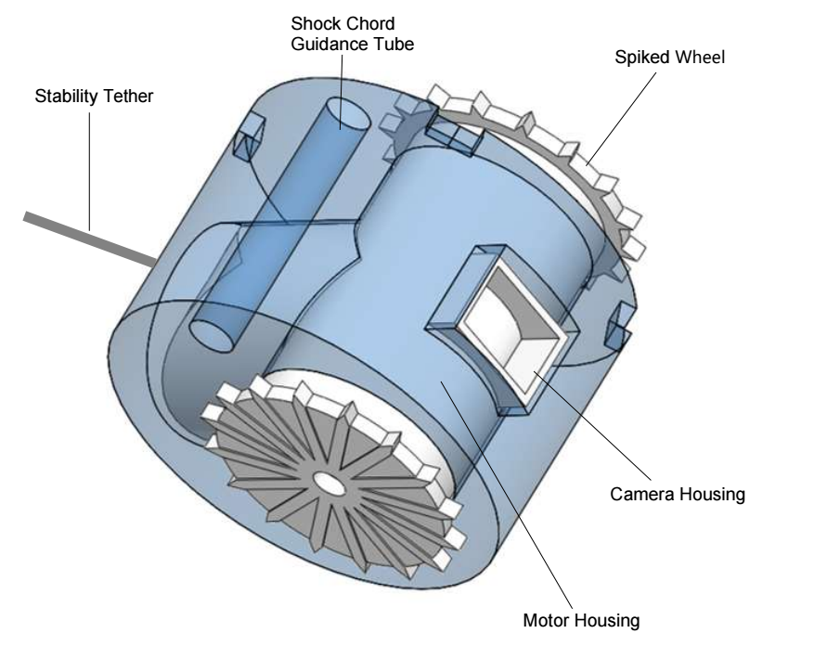
Payload Selected Design

Slide 32
Current Standing

Slide 33
Current Objectives
1
2
3
Part purchasing and subscale assembly
Sub-system testing and validation
Subscale test flight

Slide 34
Purchased Material
Recovery Components
15" Fruity Chutes: Drogue Chute | 1
48" Fruity Chutes: Class Eliptical Main Chute | 1
24" Fruity Chutes: Drogue Chute | 1
72" Fruity Chutes: Iris Ultra Main Chute | 1
Jolly Logic Chute Release 5X-series | 4
Avionics
Aim-3 Altimeter (Backup Alt.) | 1
900 mAh LiPo Battery | 4
General Components
1/4" Stainless Steel Quick Link | 8
1/4in x 1in Stainless Steel Eye Bolt w/Hardware (4pk) | 2
#1500 Kevlar Shock Cord ( /ft) | 30
LipoCharger V2 | 1

Slide 35
Priority 1 Purchasing (Sub-Scale)
Sub-Scale Vehicle Components
ID = 3.0", L = 48" Airframe - Blue Tube 2.0 | 1
3" to 38mm Centering Ring - Baltic Birch | 3
3" Airframe Bulkhead w/ eyebolt | 4
OD = 3", L = 8" Avionics Bay w/ Hardware | 1
Aerotech 38mm Hardware Kit | 1
Aerotech J575FJ-14 | 2
AeroTech 38mm Drill Kit | 1
AeroPack 38mm retainer (Blue Tube) | 1
15" Fruity Chutes: Drogue Chute | 1
48" Fruity Chutes: Class Eliptical Main Chute | 1
3-d Print Section | 1kg spool - ABS
Fins | 2
Nosecone | 1
Camera housing | 1
Sum of Spools: | 3
Recovery Components
Tinder Rocketry Eagle CO2 Ejection System | 2
CO2 Canister - 25g - 50pk | 1
Fire Retardant Blanket 3"x3" for 3" AF | 2
Fire Retardant Blanket 18"x18" for 6" AF | 2
Avionics Components
TeleMega | 1
TeleBT Ground Module | 1
Arrow Antenna 3E Yagi | 1
SMA-BNC Connector | 2
Arducam Mini | 1
Arduino Micro | 1
12V DC brushed motor | 1
General Components
2-56 Drill and Tap Set (for shear pins) | 1

Slide 36
Priority 2 Purchasing (Full-Scale & Rover)
Full-Scale Components
ID = 6.0", L = 48" Airframe - Blue Tube 2.0 | 2
6" to 75mm Centering Ring - Baltic Birch | 3
6" Airframe Bulkhead | 6
OD = 6", L = 12" Avionics Bay w/ Hardware | 1
2-56 Nylon Shear Pins - 20 ct. | 1
1515 Rail Button (large) | 2
AeroPack 75mm retainer (flanged) | 1
AeroTech 75mm Hardware Kit | 1
Aerotech L1150-R | 3
3-d Print Section | 1kg spool - ABS
Fins | 3
Nosecone | 1
Camera housing | 1
Sum of Spools: | 5
Payload Components
12V DC brushed motor | 2
Arducam Mini | 1
Arduino Mega | 1
900 mAh LiPo Battery | 1
Jumper Wire (F2M)(5.9in) | 1
Jumper Wire (M2M)(5.9in) | 1
Jumper Wire (F2F)(5.9in) | 1
3-d Print Section | 1kg spool - ABS
Frame + wheels | 1
Housing | 1
Retaining ring | 1
Sum of Spools: | 3

Slide 37
Future Work

Slide 38
Completed & In Progress
NASA Student Launch Milestones:
Project Proposal
Proposal Accepted
Preliminary Design Review (PDR)
Technical report
Slide presentation
Completed Nov. 9, 2022
Critical Design Review (CDR)
Technical Report
Final design selection for Vehicle and Payload
Subscale Vehicle Flight Testing
Slide Presentation
Due Jan. 9, 2023
Fall Senior Design Milestones:
Project Scope
Customer Needs
Functional Decomposition
Targets and Metrics
Concept Generation
Concept Selection
Risk Analysis
Bill of Materials

Slide 39
Sub-Scale Test Flight
Zenith Team Deadline for Attempt #1: Dec. 10, 2022
Flight NET: November 26, 2022
NASA Sub-scale Demo Flight Deadline: January 09, 2023

Slide 40
THANK YOU!
Future
VDR1
Critical Targets
Current Standing
Concept Generation
Payload Selection
Vehicle Selection

Slide 41
Copy Slide!

Slide 42
Copy Slide!

